Slide 1
Lecture 1a
Introduction

Slide 2
The field of Computing
Computer Science
Computer Engineering
Software Engineering
Information Systems
Information Technology

Slide 3
Computer Science: Definition 1
Definition 1
Computer Science is the study of algorithms, including:
Their formal and mathematical properties
Their hardware realizations
Their linguistic realizations
Their applications
[Gibbs and Tucker ]

Slide 4
Computer Science: Definition 1
Formal and mathematical properties of algorithms: whether they are correct and efficient, what can be computed
Hardware: building computer systems to execute algorithms
Linguistic realizations: designing programming languages and translators so that programs can be executed by the hardware
Applications: identifying important problems and designing algorithms and software to solve them

Slide 5
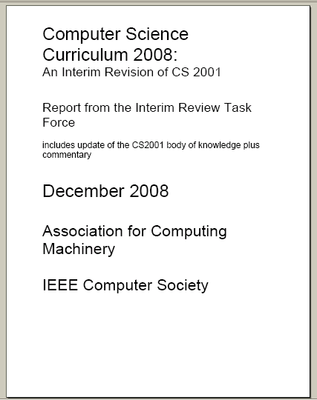

Slide 6
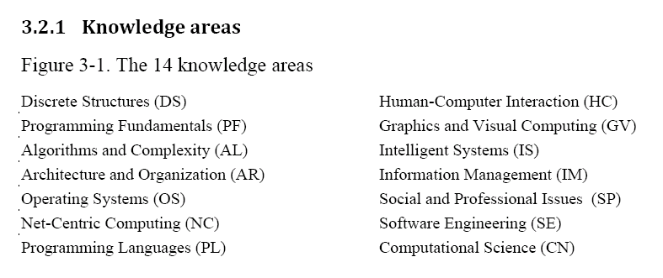
Computer Science

Slide 7
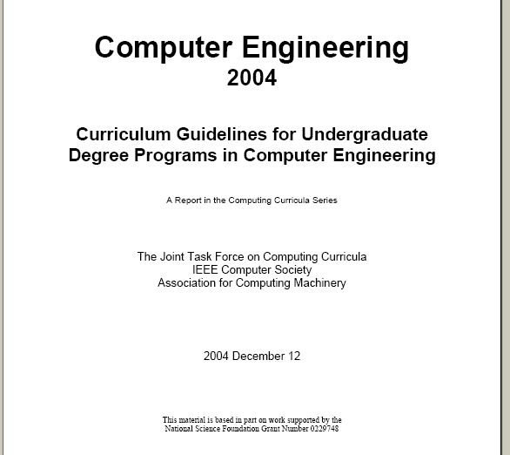

Slide 8
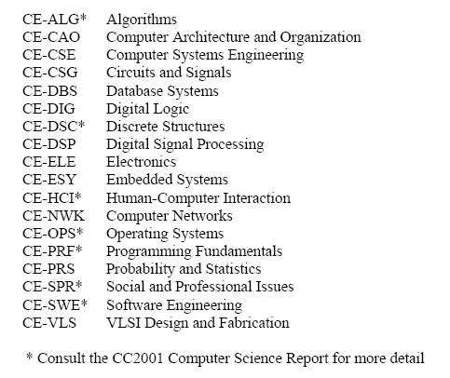

Slide 9
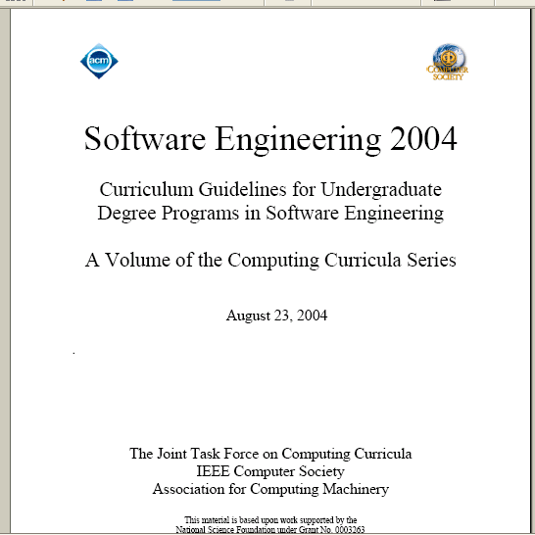

Slide 10
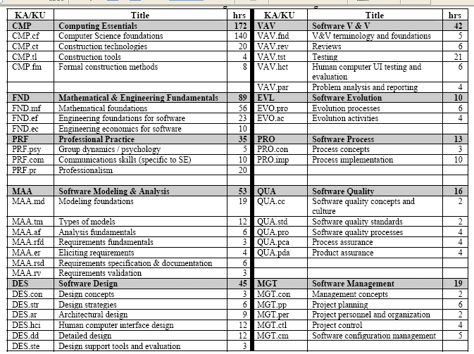

Slide 11
Conclusion
11
The algorithm is the central concept in Computer Science
Consequently, it is also a central concept in Computer Engineering and Software Engineering

Slide 12
Historically first question of CSc
Historically the first, fundamental research question in computer science:
“Are there well-defined problems that cannot be automatically solved (by a computer, regardless of the computational powers of contemporary computers or futuristic ones)?”
Efforts to answer this question led to the founding of computer science as an independent science.
Today, this field of Computer Science is known as Computability Theory.

Slide 13
Another fundamental question
“How difficult is it to solve a given algorithmic problem?”
Today, this branch of Computer Science is known as Complexity Theory.

Slide 14
Another fundamental question
If something can be computed, what resources (time, memory, …) will be needed?
A computation may be possible but not practical

Slide 15
Complexity Theory
An important achievement – an elegant scheme to classify problems according to their computational difficulty
Class P, Class NP, Is P = NP?
NP-complete, NP-hard algorithms
…

Slide 16
Problems
Some problems do not have algorithmic solutions at all
solvable / unsolvable problems
Some solvable problems are easy problems, some are hard. Some problems have algorithmic solutions that do not complete in a reasonable amount of time.
tractable / intractable problems
= easy / hard problems

Slide 17
All problems
Solvable problems
Tractable (easy) problems
Unsolvable problems
Intractable (hard) problems

Slide 18
Problems
Solvable problems
Tractable (easy) problems
There exists a solution of polynomial or better efficiency - polynomial-time problems
Intractable (hard) problems
There exists no solution of better than exponential efficiency – non-polynomial time problems

Slide 19
Typical Growth Rates (Most Common Efficiency Functions)
Hard problems
Intractable problems
Easy problems
Tractable problems
Polynomial-time
problems
Class P
19

Slide 20
Theory of Computation
Theory of Computation
Computability theory
Strongly related to the Theory of abstract automata and formal languages
Complexity theory
Strongly related to efficiency of algorithms = algorithm analysis
Efficiency of algorithms is reciprocal to complexity of algorithms
In principle the same subject, but complexity theory is more theoretical, more high-level

Slide 21
Theory of Computation – definition
The Theory of Computation is the branch of Computer Science and Mathematics that deals with whether and how efficiently problems can be solved on a model of computation, using an algorithm.
Also called
Computer Theory
Theoretical Computer Science
[Theoretical CSci has sometimes a wider meaning]

Slide 22
Dealing with Hard Problems [Major topic in Algorithm Design]
In order to deal practically with hard computational problems, one must often accept weakening of the requirement to guarantee computing the correct result. This can be done in different ways:
Accept a “reasonable” solution which is not exactly correct or, for optimization problems, is slightly suboptimal. The result of this approach is the so called approximate algorithms.
Accept that the probability for finding a correct, or optimal solution may be slightly less than 1 – randomized algorithms.

Slide 23
Dealing with Hard Problems
This leads us to two independent divisions of algorithms:
Exact (precise) algorithms vs. approximate algorithms
Deterministic algorithms vs. randomized (stochastic) algorithms

Slide 24
Dealing with Hard Problems
Algorithms | Exact | Approximate
Deterministic
Randomized

Slide 25
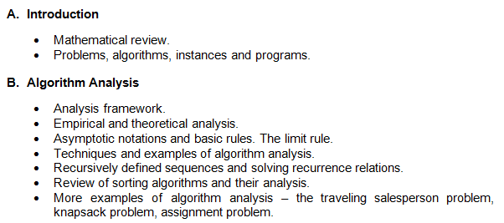
From the Course outline

Slide 26
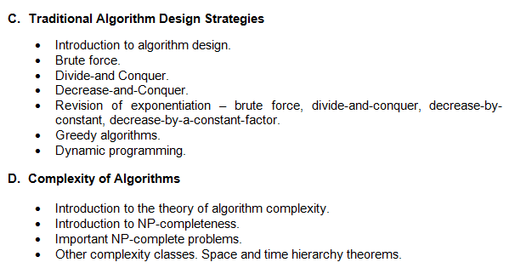
From the Course outline

Slide 27
From the Course outline
Coping with Hardness
Backtracking.
Branch-and-Bound.
Approximation algorithms.
Heuristic algorithms.
Local search.
Randomized algorithms.

